Slide 1
Testing
The process or method of finding error/s in a software application or program so that the application functions according to the end user's requirement is called Software Testing.
The major objectives of Software Testing are as follows:
Finding defects that may get created by the programmer while developing the software.
Gaining confidence in and providing information about the level of quality.
To prevent defects.
To make sure that the end result meets the business and user requirements.
To ensure that it satisfies the SRS i.e. Software Requirement Specifications.

Slide 2
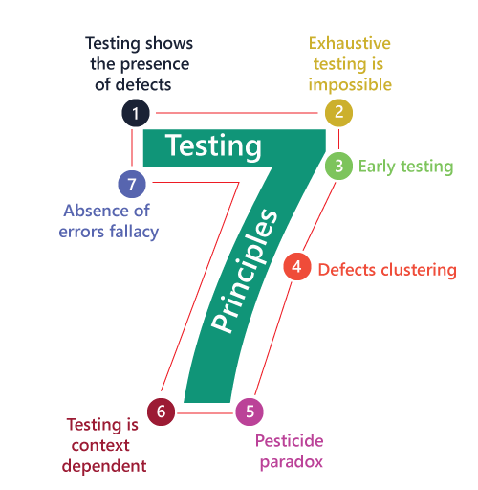

Slide 3
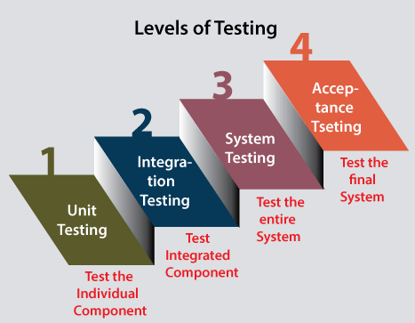

Slide 4
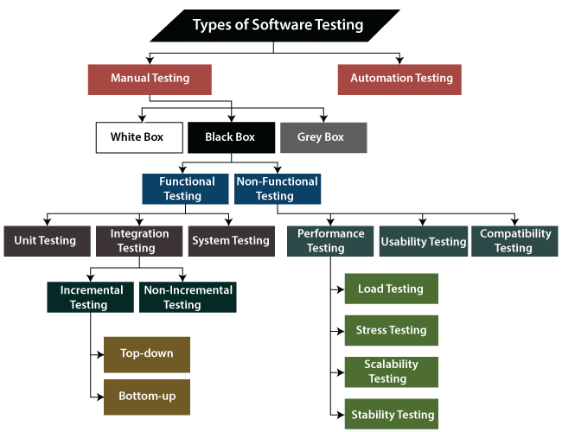

Slide 5
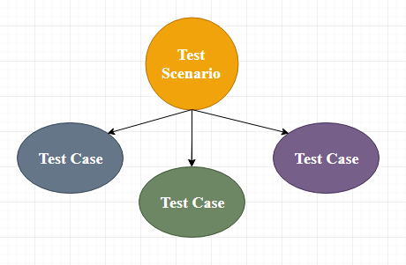
Test Case
The test case is defined as a group of conditions under which a tester determines whether a software application is working as per the customer's requirements or not. Test case designing includes preconditions, case names, input conditions, and expected results.

Slide 6
Why test cases ?
To require consistency in the test case execution
To make sure a better test coverage
It depends on the process rather than on a person
To avoid training for every new test engineer on the product

Slide 7
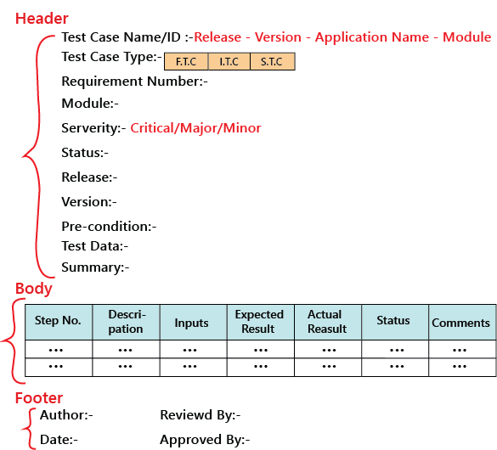
Test case template

Slide 8
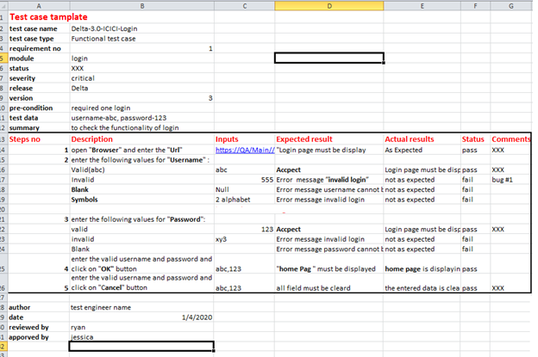

Slide 9
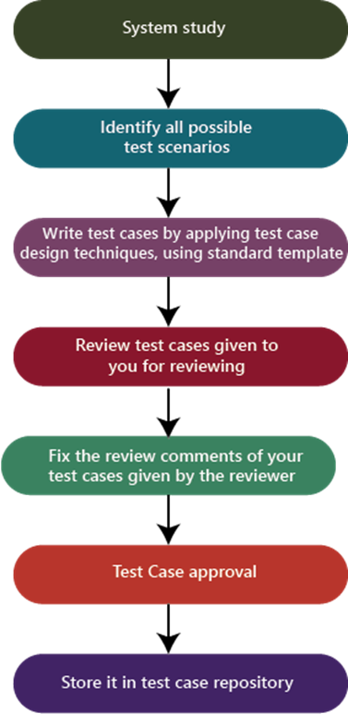
The process to write test cases

